Slide 1
YOGA POSTURE DETECTION
Ms.R. DEEPA , ASSISTANT PROFESSOR
CBIT/IT/2020-21/117
YOGITHA NANDINI (160117737030)
ARUN RAJ (160117737034)

Slide 2
ABSTRACT
Yoga is an ancient Indian art, but from the last decade, a large number of people are adopting yoga as part of their life. This is due to the health benefits. It is important to do this exercise in right way especially in right posture. So, we came up with this project which helps people to gain some knowledge about the yoga posture which they do.
In this project, we train a model which helps to classify the name of the yoga posture. we take the input of image posture from the user and output the name of pose and give the text of steps to be performed for the yoga posture and voice for the yoga posture steps. Finally gives the visual view of his/her input posture and the relevant output posture from the training set.

Slide 3
INTRODUCTION
Yoga has been attracting peoples from so many years but from the last decade, a large number of people are adopting yoga as part of their life. Even, during these long months of lockdown, it's difficult for people to go out to exercise, run, and do things they can to stay fit. Yoga is something that can be done indoors easily and has a lot of benefits. With the help of our project yoga posture detection, people can not only classify the pose but also check how well their posture as compared to a perfect yoga poses.

Slide 4
PROBLEM STATEMENT
In our project, we wanted the user to do yoga in a proper manner without hurting themselves. This project helps to know the name of posture performed by the user and guides the user with the steps to be performed for the yoga posture to be perfect. Both steps and the visual view of his/her input, the relevant output postures are given in order to adjust their posture.

Slide 5
LITERATURE SURVEY
Paper Title | Author Name | Advantages | Disadvantages
Yoga posture recognition by detecting human joint points in real time using Microsoft Kinect, Year 2017, IEEE | Muhammad Usama Islam , Hasan Mahmud , Faisal Bin Ashraf , Iqbal Hossain and Md. Kamrul Hasan | Graphical analysis of the deviation of angles with reference model | Kinect device is expensive and not user friendly
Computer-assisted yoga training system Year 2018, Springer | Hua-Tsung Chen & Yu-Zhen He & Chun-Chieh Hsu | Takes front view and side view. Uses distance function and gives visualized view for posture rectification | It just gives similar yoga postures body map and skeleton map

Slide 6
LITERATURE SURVEY
Paper Title | Author Name | Advantages | Disadvantages
Machine learning gesture analysis of yoga for exergame development, Year 2018, IEEE | Paula Pullen , William Seffens | Build the exergameusing Adaboost gesture analysis | Kinect device is expensive and not user friendly
Recognition of yoga poses using EMG signals from lower limb muscles, Year 2019, IEEE | Pradchaya Anantamek , Narit Hnoohom | Myoware muscle sensor, Embedded system are used. Weka to classify yoga postures. SMO, J48, RF algorithms gives accuracy. | There is discomfort while needle electrodes inserted. Afterwards, muscle may feel a little sore for few days. Experts are required to perform EMG.

Slide 7
LITERATURE SURVEY
Paper Title | Author Name | Advantages | Disadvantages
Implementation of Machine Learning Technique for Identification of Yoga Poses, Year 2020, IEEE | Yash Agrawal, Yash Shah, Abhishek Sharma | TF pose estimation algorithm is used. 94.28% accuracy altogether was attained of all machine learning models. | No visual view to guide the user.

Slide 8
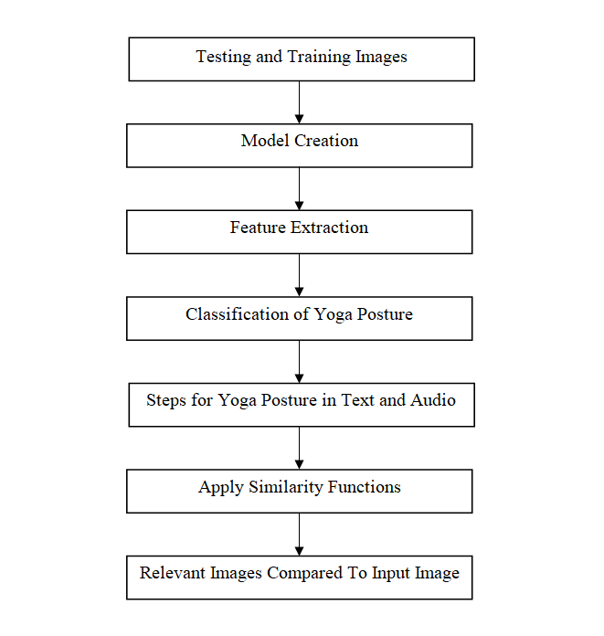
SYSTEM DESIGN

Slide 9
IMPLEMENTATION
Dataset is created for different number of yoga poses. Then, Preprocess the images. Now we can proceed to build a simple convolution neural network. After compiling the network we get the model.
The model helps us to classify the name of the yoga posture based on the class. According to the class name it also gives the step to be followed to achieve perfect pose in terms of text and audio format.
The similarity functions helps us to predict the most relevant images compared with the user input image from the training set.

Slide 10
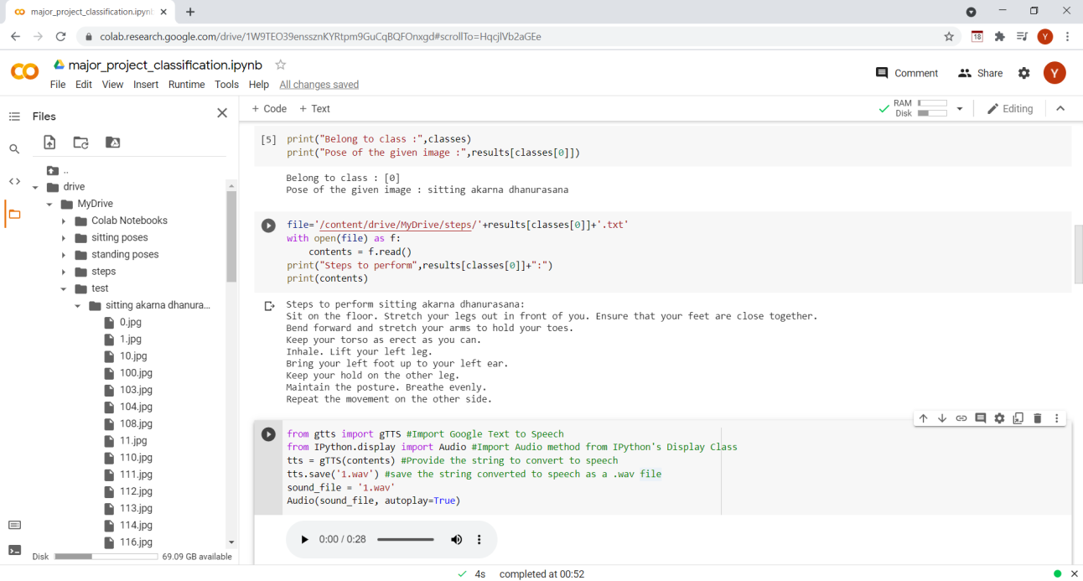
TESTING AND RESULTS

Slide 11
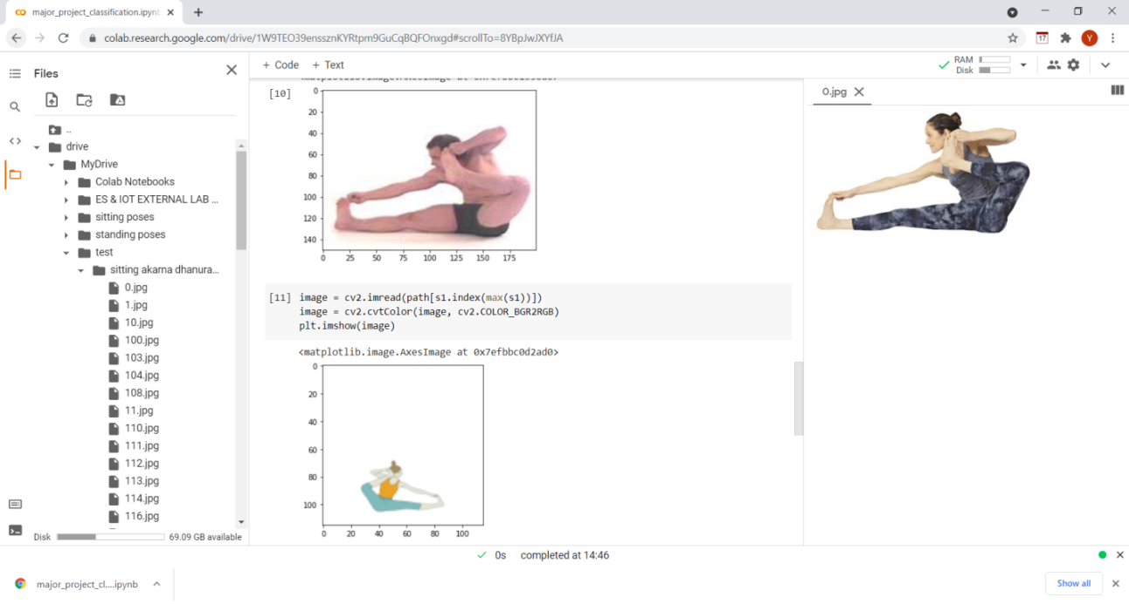
TESTING AND RESULTS

Slide 12
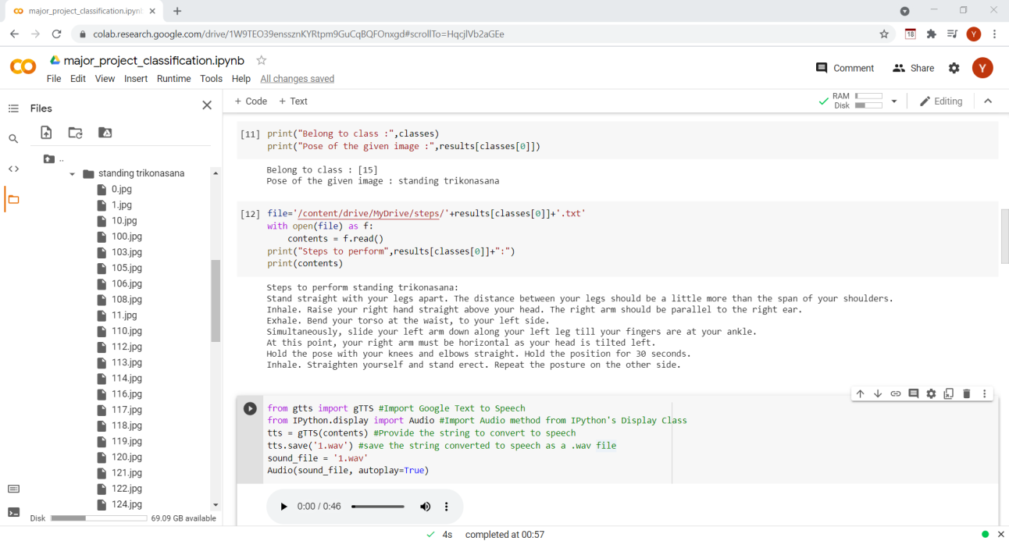
TESTING AND RESULTS

Slide 13
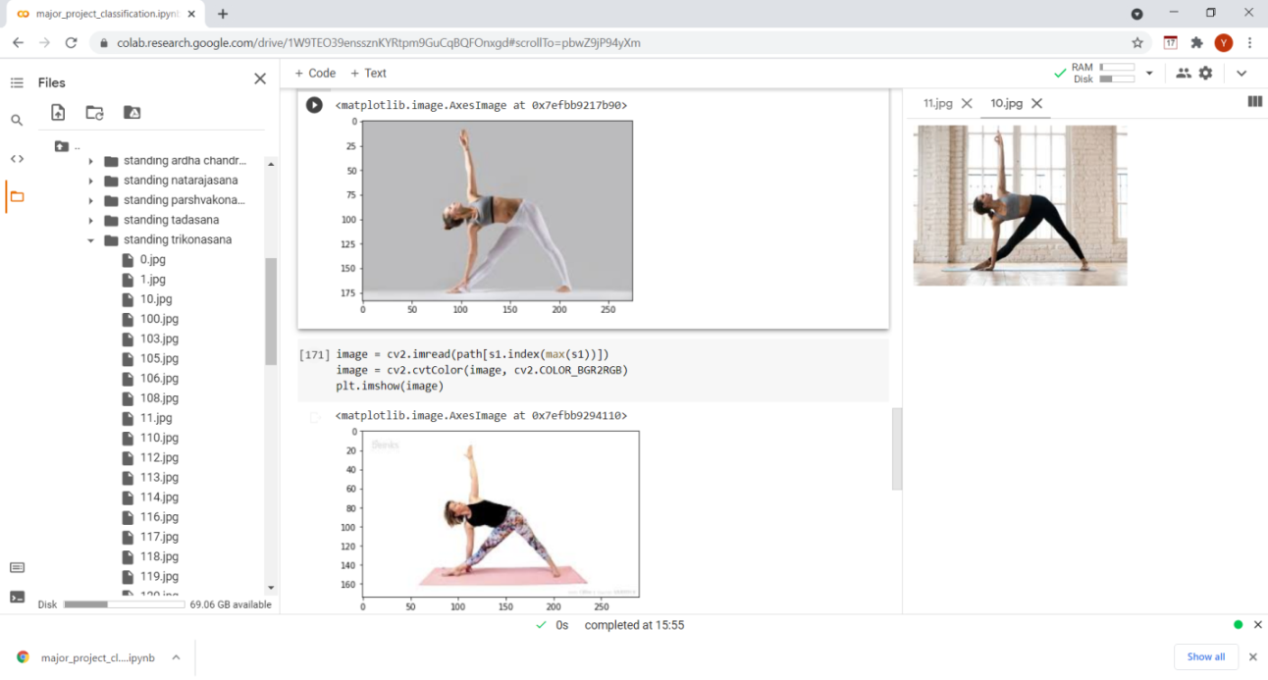
TESTING AND RESULTS

Slide 14
CONCLUSION AND FUTURE SCOPE
During these long months of lockdown, it's difficult for people to go out to exercise, run, and do things they can to stay fit. With the help of yoga posture detection, people can not only classify the pose but also check how well their posture as compared to a perfect yoga poses.
Future scope can be Adding real-time prediction feature, so that person can perform yoga in front of the webcam and yoga posture detection can classify the pose in real-time. It can also be extended by adding scoring features to tell how well your yoga posture is comparing the perfect pose with the user's pose will help the user to improve by correcting their posture.

Slide 15
REFERENCES
[1]Muhammad Usama Islam, Hasan Mahmud, Faisal Bin Ashraf, Iqbal Hossain, Md. Kamrul Hasan “Yoga posture recognition by detecting human joint points in real time using Microsoft Kinect.” IEEE Region 10 Humanitarian Technology Conference (R10-HTC). pp.1-5, 2017.
[2]Hua-Tsung Chen & Yu-Zhen He & Chun-Chieh Hsu. “Computer-assisted yoga training system.” Springer, 2018.
[3]Pullen, Paula, and William Seffens. “Machine learning gesture analysis of yoga for exergame development.” IET Cyber-Physical Systems: Theory Applications, vol.3, no.2, pp.106-110, 2018.
[4]Pradchaya Anantamek , Narit Hnoohom. “Recognition of yoga poses using EMG signals from lower limb muscles.”, IEEE, 2019.
[5]Yash Agrawal, Yash Shah, Abhishek Sharma. “Implementation of Machine Learning Technique for Identification of Yoga Poses.”, IEEE, 2020.

Slide 16
THANK YOU ☺

